Slide 1
Website Design Concepts

Slide 2
Contents
Objectives
To design a simple web site using a wire frame
Contents
Concepts and Ideas
Wire Framing
Notes:
At the end of this session you will be able to:
Explain the aims and objectives of the course
Construct a simple Web page using an ASCII text editor
Display that page using a browser
Contents:
Course administration
Web introduction
Intranets and the Internet
Web benefits
Terminology

Slide 3
Defining the User Experience
User Experience (UX) goes beyond simply looking at usability
A user experience is: “A person’s perceptions and responses that result from the use or anticipated use of a product, system or service”
Does it work as expected?
Were users able to accomplish their tasks?
Did users have an overall positive experience?

Slide 4
Exercise
Review the following web sites specifying
Are they good/bad?
What makes them good/bad?
Which do you prefer and why?
Compare:
http://searchengineland.com/analyzing-the-major-shopping-search-services-10965
https://www.google.co.uk/shopping
https://shopping.yahoo.com/

Slide 5
Exercise
What is it that these sites bad?
http://www.007museum.com/
http://www.arngren.net/
Rudgwicksteamshow.co.uk
http://www.bolenreport.com/
http://www.pennyjuice.com/
http://www.lingscars.com/

Slide 6
How Users Think
Users appreciate quality and credibility
Users don’t read, they scan (http://www.etre.com/usability/eyetracking/showme/)
Web users are impatient and insist on instant gratification
Users don’t make optimal choices
Users follow their intuition
Users want to have control
Notes:
Users appreciate quality and credibility If a page provides users with high-quality content, they are willing to compromise the content with advertisements and the design of the site. This is the reason why not-that-well-designed web-sites with high-quality content gain a lot of traffic over years. Content is more important than the design which supports it.
Web users are impatient and insist on instant gratification If a web-site isn’t able to meet users’ expectations, the designer failed to get their job done properly. The higher the cognitive load and the less intuitive the navigation, the more willing will users be to leave the web-site and search for alternatives.
Users don’t make optimal choices. Users don’t search for the quickest way to find the information they’re looking for. Neither do they scan web pages in a linear fashion (going sequentially from one section to another). Instead users choose the first reasonable option. As soon as they find a link that seems like it might lead to the goal, there is a very good chance that it will be immediately clicked.
Users follow their intuition. In most cases users muddle through instead of reading the information a designer may have provided. “If we find something that works, we stick with it. It doesn’t matter to us if we do or don’t understand how things work, as long as we can use them.”
Users want to have control. Users want to be able to control their browser and rely on the consistent data presentation throughout the site.

Slide 7
Principles of Effective Web Design - 1
Don’t make users think
Bad: www.rudgwicksteamshow.co.uk
Don’t squander users’ patience
Bad(ish): http://www.thetimes.co.uk/
Try to focus users’ attention
Good: www.bbc.co.uk
Bad: www.lingscars.com
Notes:
Don’t make users think Web pages should be obvious and self-explanatory. When creating a site, the designer’s job is to get rid of the question marks — the decisions users need to make consciously, considering pros, cons and alternatives.
If the navigation and site architecture aren’t intuitive, the number of question marks grows and makes it harder for users to comprehend how the system works and how to get from point A to point B. A clear structure, moderate visual clues and easily recognizable links can help users to find a path to what they are looking for. (http://www.rudgwicksteamshow.co.uk/)
Don’t squander users’ patience When offering a service to your visitors try to keep the user’s requirements to a minimum. The a user has to do to test a service, the more likely they are to try it out. First-time visitors will probably be willing to play with the service. However, they won’t want to fill in long web forms for an account they may never use in the future. Let users explore the site and discover its services without forcing them into sharing private data.
Try to focus users’ attention Web sites usually contain both static and dynamic content, some aspects of the user interface attract attention more than others do. Images are more eye-catching than text, bold text stands out from plain. The human eye is a highly non-linear device and it quickly recognises edges, patterns and motions. Consequently videos and animations that start as soon as a page is viewed will definitely attract a users attention. However they are usually extremely annoying and distract from what the user is trying to do.

Slide 8
Principles of Effective Web Design - 2
Clearly show what functions are available
http://en.wikipedia.org/wiki/Mystery_meat_navigation
Use simple, concise text and strive for simplicity
www.qa.com
Don’t be afraid of white space
Convention is good
Test early and often
Notes:
Clearly show what functions are available It doesn’t really matter how this is achieved. What matters is that the content is well-understood and visitors feel comfortable with the way they interact with the system.
Use simple and concise text Write the minimum amount of text to make yourself understood. Users will skip long text blocks without images. Avoid jargon and technical names. For example, “sign up” is better than “start now!” is better than “explore our services”.
Strive for simplicity From the visitors’ point of view, the best site design is a pure text, without any advertisements or further content blocks matching exactly the query visitors used or the content they’ve been looking for. This is one of the reasons why a user-friendly print-version of web pages is essential for good user experience.
Don’t be afraid of white space It’s really hard to overestimate the importance of white space. Not only does it help to reduce the cognitive load for the visitors, but it makes it possible to perceive the information presented on the screen. When a new visitor approaches a design layout, the first thing he/she tries to do is to scan the page and divide the content area into digestible pieces of information.
Convention is good Conventional design of site elements doesn’t need to result in a boring web site. Most online shops work in very similar ways.
Test early and often Testing one user is 100% better than testing none and testing one user early in the project is better than testing 50 near the end

Slide 9
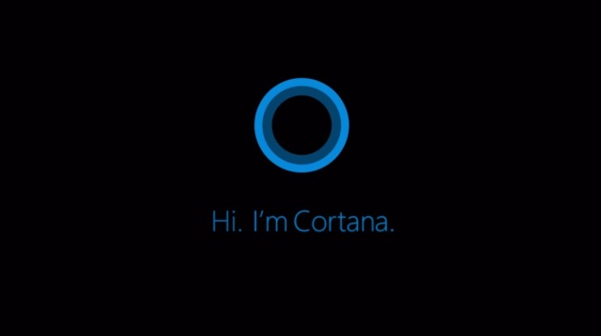
The 4 Principles of User Interface Design - Accessible
Tailors to personal needs
Works well on user’s preferred device
Supports differently able people
Cortana
Notes:
Think about the intended users of the website are. Do we have to worry about people with disabilities (almost certainly yes).

Slide 10
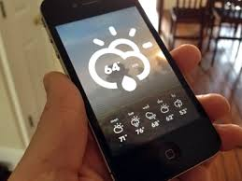
The 4 Principles of User Interface Design - Usable
Easy to learn
Quick to use
Error free
Satisfying to use
Supports power users
Weather App

Slide 11

The 4 Principles of User Interface Design - Engaging
It provides flow experience
Its compelling – you want to use it all the time
It’s a pleasure to use
Playstation 4

Slide 12
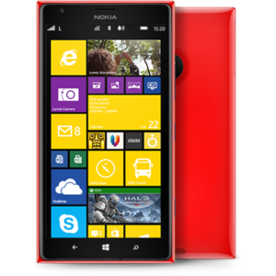
The 4 Principles of User Interface Design - Rewarding
It uniquely useful
Its personally or socially valuable
It’s part of your everyday life
Windows Phone

Slide 13
Other Considerations - 1
Is this a real time environment?
Is the data the user sees potentially “out of date?”
Data Capture
Use the right control for the job (HTML5 offers some useful additions)
Ensure website copes with different displays (pc, tablet, smart phone) and browsers (Chrome, IE, Opera, Safari, Firefox)
Bootstrap should make this relatively straightforward
Copyright
Copyright © 2015 QA
Animation/Sound
Use carefully
http://www.angelfire.com/super/badwebs/
Notes:
Real Time Environment Will the data being shown to the user be live E.G. the latest share price, exchange rate or stock level. Will the site have to manage multiple users potentially updating the same piece of data at the same time?
Data Capture Use appropriate input controls to simplify the process for the user. Check boxes for true/false; radio buttons for bigger selections; For numeric data place “masks” onto fields to ensure correct data is input via HTML5’s number or range input types.
Ensure website copes with different displays and browsers Use of Bootstrap (a popular html, css and javascript framework for developing, mobile-first websites)
CopyRight In order to stake a claim of ownership over a website it is always useful to show a copyright notice in the footer of your web pages. The generally accepted format is: Copyright © 2015 QA
It is important to make sure that the year is current. Use the HTML code &copy; to display the copyright symbol, you must also ensure the word ‘copyright’ appears.
Animation/Sound When animations and sounds are used on a website they can be either brilliant or appalling. They obviously attract attention and when used well they often subtly help users to focus on important parts of the page.
The following link discusses Google’s ideas around the good use of animation: http://www.google.co.uk/design/spec/animation/authentic-motion.html#

Slide 14
Other Considerations - 2
Data Protection Act
Protects users from misuse and abuse of online data
Not just name and address but any personal information
Companies must:
Notify Office of Information Commissioner
Must adhere to eight legal principles (https://ico.org.uk/for-organisations/guide-to-data-protection/data-protection-principles/)
Notes:
When it comes to surfing the internet, the Data Protection Act is your friend. It is there to protect you from misuse and abuse of your online data. The Data Protection Act (DPA) covers the processing of personal data. The term personal is not just limited to your name and address, but any data that could reasonably be put together with other information to divulge personal information about yourself. Thus, if you live alone, your phone number could count as personal data. Your email address almost certainly would count.
Processing relates to pretty much any operation on your data involving a computer - from selecting your name for a mailing, to reading it off a screen during a sales call.
Companies and organisations that would like to process your data need to do two things. First of all, they should notify the Office of the Information Commissioner (a government body) that they are doing so. That way, it is possible to know who is legitimately processing data and who is not.
Secondly, they need to adhere to eight principles embodied in the law. For instance, data must be obtained “fairly” - that is, at the point of collection it must be made clear what the data will be used for. It must be accurate and up to date and it must be held securely.
Most importantly – and this applies even more so to data collected online – your permission is needed before the data is processed. When it is collected from the internet an “opt-out” (telling you that it will be used unless you say no) is not good enough. It must be an “opt-in”.

Slide 15
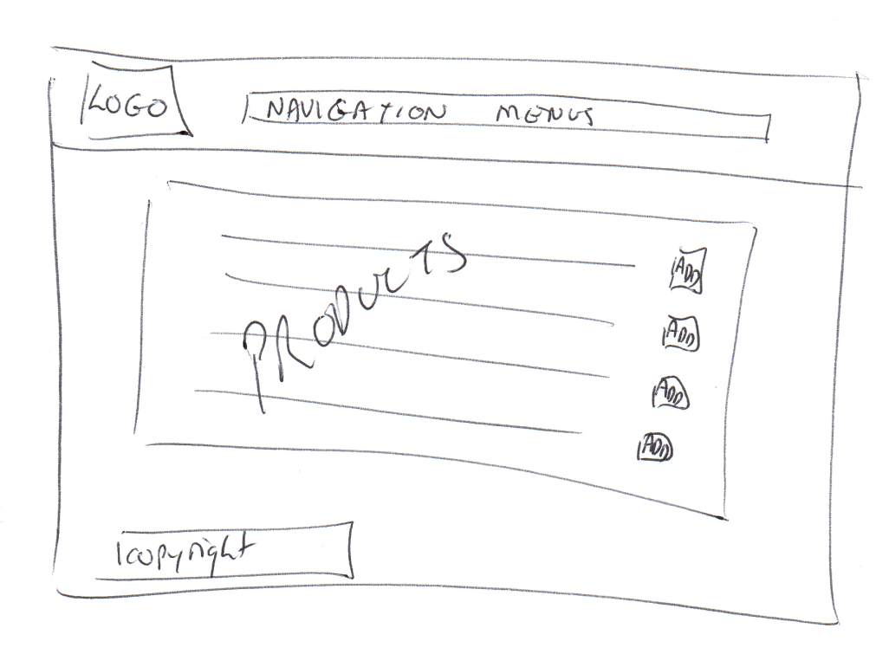
Creating Wireframe Prototype
Things to include in a Web page wireframe:
boxes for primary graphical elements
placement of headlines and sub-heads
simple layout structure
calls to action
text blocks
Notes:
A web wireframe is a simple visual guide to show you (and potential users) what a web page would look like. It suggests the structure of a page, without using any graphics or text. A website wireframe would show the entire site structure - including what pages link to where.
Web wireframes are a very good way to start the design phase. And whilst there are wireframing tools available fore purchase planning can start with something as simple as a piece of A4 paper and a pen.

Slide 16
How to Build a Web Wireframe
Draw a big rectangle to show entire page or just the visible section
Sketch the layout (2 or 3 columns)
Add a box for a header graphic
Write “Headline” where h1 headline needs to be
Write “Sub-Head” where h2 and other lower level headlines should be
Add boxes for other images
Add navigation. If you are planning tabs, just draw boxes and write “navigation” over the top or put bulleted lists in the columns where you want the navigation. Do not write content.
Add additional elements to the page and identify what they are with text
Repeat the above processes for other site pages

Slide 17
Wireframe Walkthrough
When ready walkthrough the wireframe design pretending to enter data and click buttons as if the site were real
Try to ensure:
Navigation to all pages is as you expect
Required functionality is present
Feedback is given
It may be useful to get another person to test the wireframe for you
When you are satisfied the wireframes work you may want to create more sophisticated prototypes by either:
using post it notes and cut up pieces of paper
using prototyping software (Balsamiq Mockups, Microsoft Visio, LucidChart or OmniGraffle)

Slide 18
Review
Objectives
To design a simple web site using a wire frame
Contents
Concepts and Ideas
Wire Framing

Slide 19
Test Plans

Slide 20
Contents
Objectives
To understand the need for written test plans
Contents
The need for formalised testing
The Software Test Plan
Test Cases
Designing tests
Example Test Plans

Slide 21
The need for formalised testing
Problems of ad-hoc testing:
Might miss something
Might repeat the same test
What happens when you make changes to the code?
Advantages of a formal Test Plan:
Can add additional tests to the plan at any time
You always know where you are (what tests you still have to run)
Input for regression testing
A carefully structured test plan can help locate errors
Notes:
Developers who haven't learnt how to test may not do any proper testing at all - they may just run their code once or twice and if it produces something that looks right in those circumstances then that may be as far as they go. The may then be surprised to find out later that their code fails to work correctly for many of the people visiting their page where alternatives that were never tested frequently occur. The problem is that if you don't run a test of all of the alternative paths through your code that there is no guarantee that all of them will work correctly. Unless you actually identify all of the alternatives and what should happen with each, there is no way that you can properly test your code.
A formal test plan is written down and lists a whole series of tests to be carried out along with the expected results that each test is expected to give if the test is successful.
Just listing the tests that you intend to run is not enough. For your list to be really useful you should include information on exact values to feed in to perform the particular test and what you expect the results of the test to be. If you don't know what result you expect from a test then you have no way of telling whether the test worked.
If you missed a test at the time you first wrote the code you can add the test to your list . If you make changes to your code you will also be able to re-use the list to retest your code to make sure that the amendment didn't break anything else.
Your written test plan also serves one additional purpose - it identifies those tests that you have run and those you have yet to run against the code so that you know exactly where you are at in your testing.

Slide 22
The Software Test Plan
A formal document that includes:
A list of tests
exact values to feed in to perform a particular test
The expected results
Best created early in the development cycle
Notes:
The earlier in the process that you write the test plan the more useful that test plan will be. The ideal time to write the test plan is before you start writing the code. The reason for this is that a test plan isn't just useful for testing, it can also assist with the earlier steps in the development of the code.
If you write the test plan straight away it will assist you in deciding exactly how the code is supposed to work. Your test plan will list all of the possible situations that the code needs to be able to deal with and that can mean a list of questions that you need to answer. While the main paths through the code may be obvious as to what is supposed to happen, the test plan needs to cover all of the paths that you expect to have with the code and needs to answer the question of what should happen when each of those situations occurs. By giving thought to the expected results of all the tests at the start you will be able to better design your code to cater for all these less common paths in the most appropriate manner.
The test plan can also be useful when writing the code since the test plan clearly identifies all of the paths that you expect the code to have. Referring to the test plan while writing the code can help to answer questions as to what the code is supposed to do next.

Slide 23
Designing Test Cases
Design Objectives
Detect as many errors as possible
Minimise test development costs
Minimise test execution costs
Minimise test maintenance costs
After initial identification of items to be tested
Assign priorities of test types then individual cases based on business needs
Assign priorities based on risk assessment
Elaborate the design of individual test cases
Notes:
A single test case normally corresponds to a single or related sets of requirements. Use the objectives from the Master Test Plan and negotiate with expert users to determine the priority of test types, then the test cases within those types. Risk can be assessed with input from programmers, designers and architects. Be aware that one customer may think an untested condition is trivial, while another may think it crucial because of heavier usage.

Slide 24
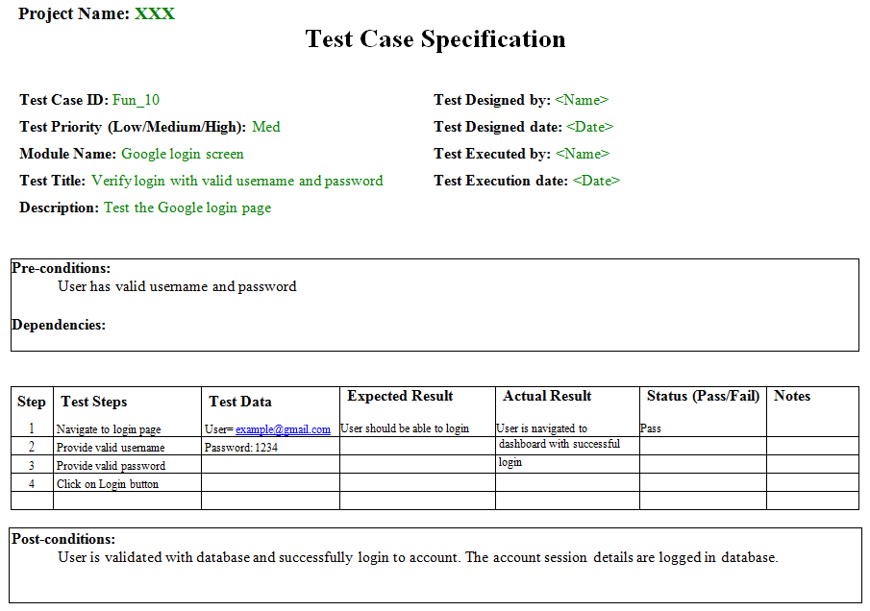
What is a Test Case?
Test Case Specification
Identifier
Objective
Input data
Test procedure
Expected output
Notes:
A typical test case description in a test plan from the System or Acceptance stages. Unit test plans are subject to greater change and usually less formal. The above is the international standard for describing test cases.

Slide 25
Designing Test Cases
Use a combination of:
Functional Tests (Black Box)
“Unit Tests” (White Box)
Equivalence testing
Boundary testing

Slide 26
Designing Test Cases: Techniques
Test Data: Equivalence Classes
Two or more tests that you expect to produce the same result
Same input variable; similar operations; same output variable
Example: valid input values range from 1 to 99
Any number from 1 to 99 (valid input)
Any number less than 1 (invalid)
Any number more than 99 (invalid)
Any non-number (invalid)
Assign a single test case to all valid equivalence classes
Assign a single test case to each invalid equivalence class
Don’t group invalid classes into a single test case!
Number?
no
yes
no
>= 1?
no
<= 99?
Invalid Result
Valid Result

Slide 27
Designing Tests: Techniques
Test Data: Boundary Values
Test either side of boundaries
For consecutive ranges…
Less than smallest allowed value
Smallest allowed value
Largest allowed value
Greater than largest allowed value
For well-defined sets…
Member of set (e.g. a number for numeric input)
Non-member of set (e.g. special character for alphabetic input)
For lists…
Each item

Slide 28
Boundary Test Example
Input must be a 5-digit number between 10000 and 99999
Choose test cases at the boundaries of the partitions:
09999
10000
50000
99999
100000
Less than 10000 | Between 10000 and 99999 | Greater then 99999

Slide 29
Example Test Plan – Part 1
Login Window
We will make use of several different names and passwords to log in to the system, so will enter these into the login window.
We will enter the following combinations:
a valid user name and password
a valid user name and an invalid password
a invalid user name and a valid password
We will also test OK and Cancel buttons on this window in combination with the above tests.

Slide 30
Example Test Plan – Part 2
Test Name | Steps | Expected Result | Actual Result | Status
Valid Logon | Enter valid user ID and password. Press OK | Taken to Main Form |  | Pass
Cancel with valid credentials | Enter valid user ID and password. Press Cancel | Program terminates |  | Pass
Bad Password | Enter valid user ID and invalid password. Press OK | Error Message. Stay with Logon form
Invalid userID | Enter invalid user ID and “invalid” password. Press OK | Error Message. Stay with Logon form

Slide 31
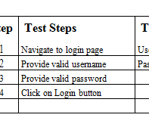
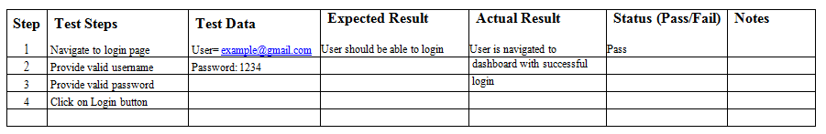
Test Steps Example
Notes:
This is the sequence of actions required to execute the test case “Valid Login”. Individual steps from other test cases can often be reused in the new design - shown by naming the steps above.

Slide 32
Logging the Results
Expected Behaviour vs. Actual Behaviour
Create a test log that records and compares results and comments on any discrepancies
Priority and Severity
Cross-referenced evidence of testing, ie:
file print, printed output, screen prints as necessary to show test results

Slide 33
Review
Test Plans make testing formal:
You know where you are
Provide Documentation
Encourage Regression Testing
Promote Understanding

Slide 34
Further Links - 1
Essential Principles for Good Web Design
http://design.tutsplus.com/tutorials/9-essential-principles-for-good-web-design--psd-56
Usability Heuristics for User Interface Design
http://www.nngroup.com/articles/ten-usability-heuristics/
Introduction to Usability
http://www.nngroup.com/articles/usability-101-introduction-to-usability/
Things People Hate About Your Website
http://blog.hubspot.com/blog/tabid/6307/bid/32307/15-Things-People-Absolutely-Hate-About-Your-Website.aspx
Web Design Do and Don’ts
http://www.learningwebdesign.com/pdf/lwd2_dos_and_donts.pdf
Google Animation Guidelines
http://www.google.co.uk/design/spec/animation/authentic-motion.html#

Slide 35
Further Links - 2
WebSite Design Ledger 20 do’s and don’ts
http://webdesignledger.com/tips/20-dos-and-donts-of-effective-web-design
A list of some useful design don’ts
http://www.greenville.k12.sc.us/Employees/main.asp?titleid=teacherwebdonts

